Slide 1
Opti Freight Application
Submitted By:
N.NIKHIL
2023tm93644

Slide 2
PURPOSE OF THE SYSTEM
Enables Hospitals to order the required equipment through our connect application
Enables vendors to add their products
Create labels for the orders and send to logistics services for delivery
Our Application will serve as a single serving platform for multiple type of end users having access to the platform to view, upload, configure.

Slide 3
KEY REQUIREMENTS :
FUNCTIONAL REQUIREMENT:
Users can browse and search for products by category, brand, price, etc.
Users can view detailed product information, including descriptions, reviews, and images.
Users can add items to their shopping cart and checkout securely.
The system must support various payment methods (credit cards, PayPal, etc.).
Orders can be tracked in real-time.
The system should offer customer service and support options.

Slide 4
NON-FUNCTIONAL REQUIREMENT :
The system must be highly available and have low response times.
The system must be scalable to handle high traffic volumes.
The user interface must be intuitive and user-friendly.
The system must be secure and comply with data privacy regulations

Slide 5
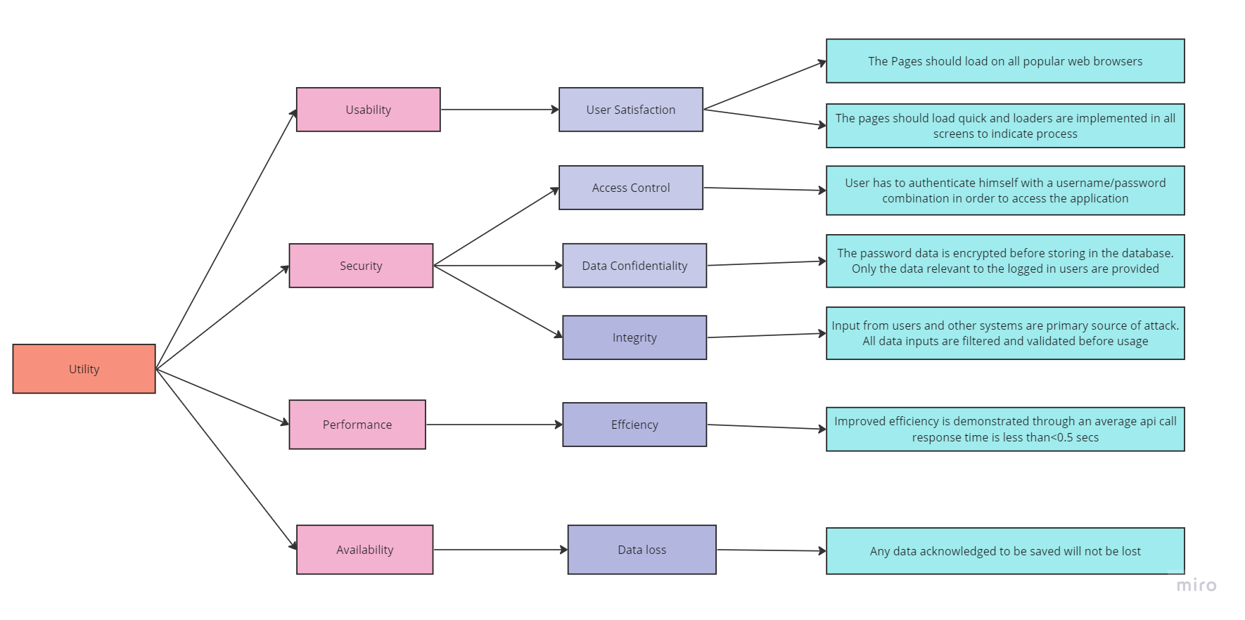
UTILITY TREE :

Slide 6
TACTICS USED TO ACHIEVE TOP 5 ASR’S:
Availability :
Use a distributed architecture with load balancing and caching.
Implement horizontal scaling to add more servers as needed.
Utilize cloud computing platforms for elastic scaling.
Secure transactions:
Use HTTPS for secure communication.
Employ strong encryption for data storage and transmission.
Implement tokenization for sensitive payment information.
Regularly conduct security audits and penetration testing.

Slide 7
3. Usability
User satisfaction is achieved by,
Making the system browser agnostic.
Ensuring the page load time is less and a loader is displayed to inform the user about any background processes in the user interface.
4. Performance
The response time of the Api call is optimized as much as possible with an average of <0.5 sec
5.Modifiability
The system is modularly decomposed to make sure that it can be modified easily.

Slide 8
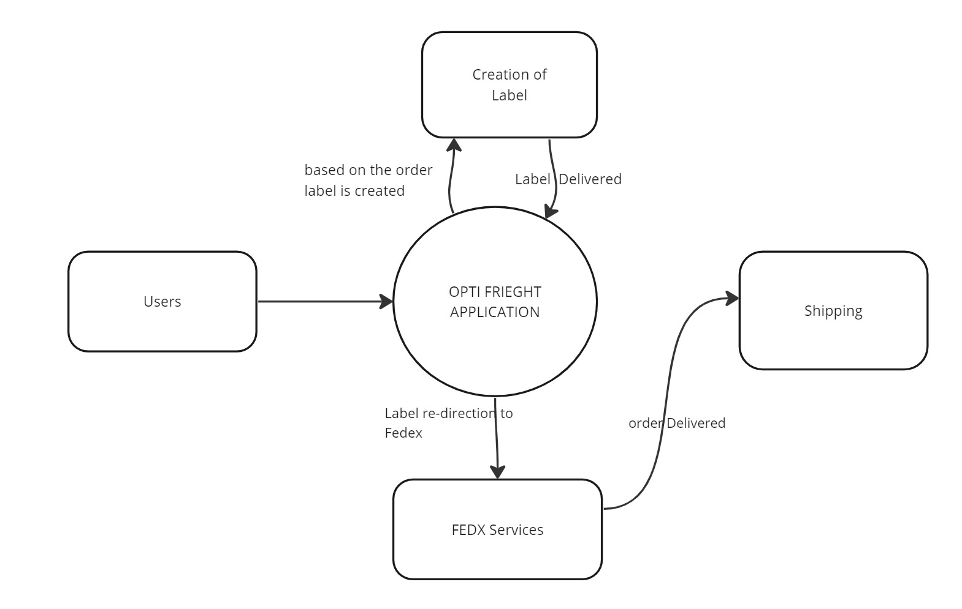
CONTEXT DIAGRAM:

Slide 9
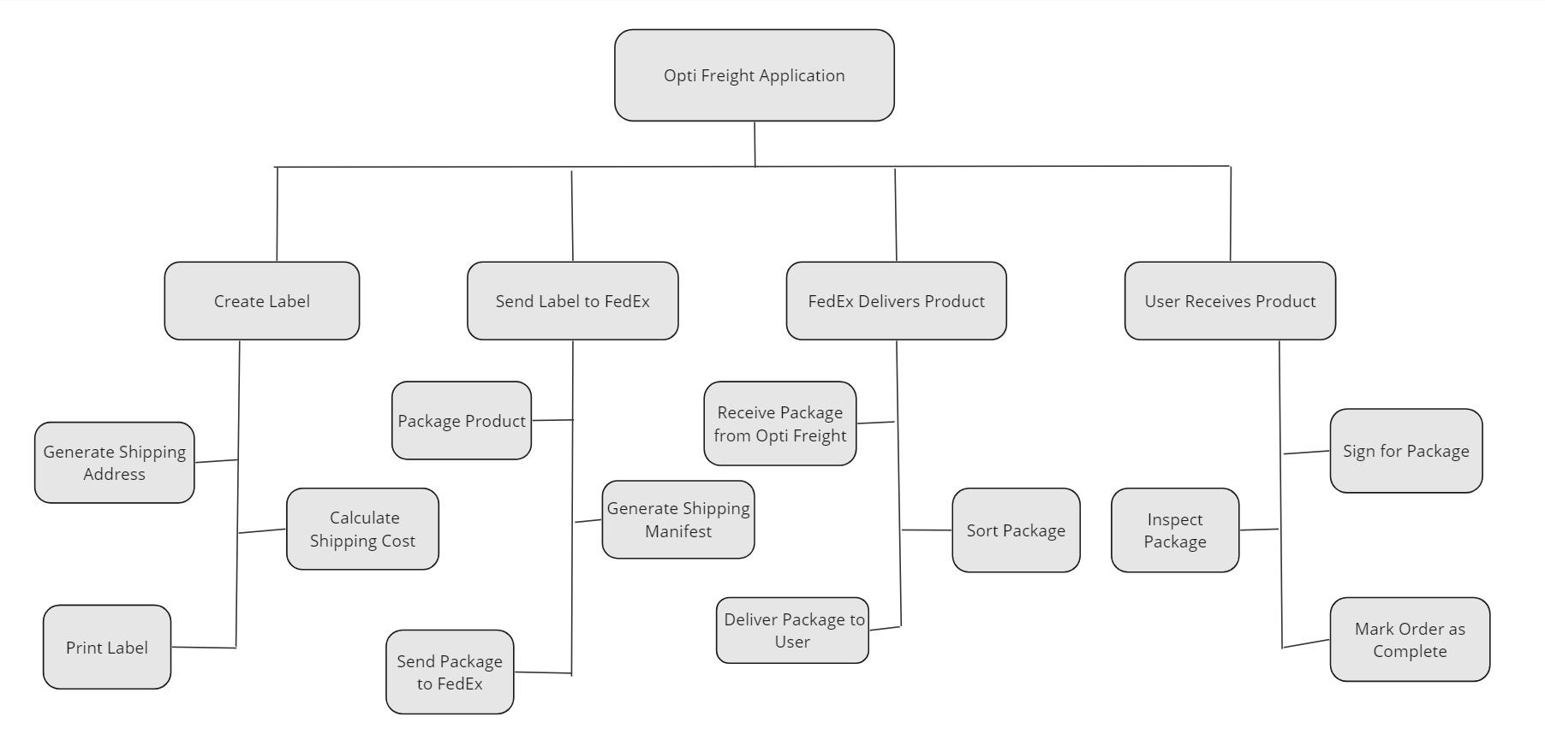
MODULE DECOMPOSITION DIAGRAM:

Slide 10
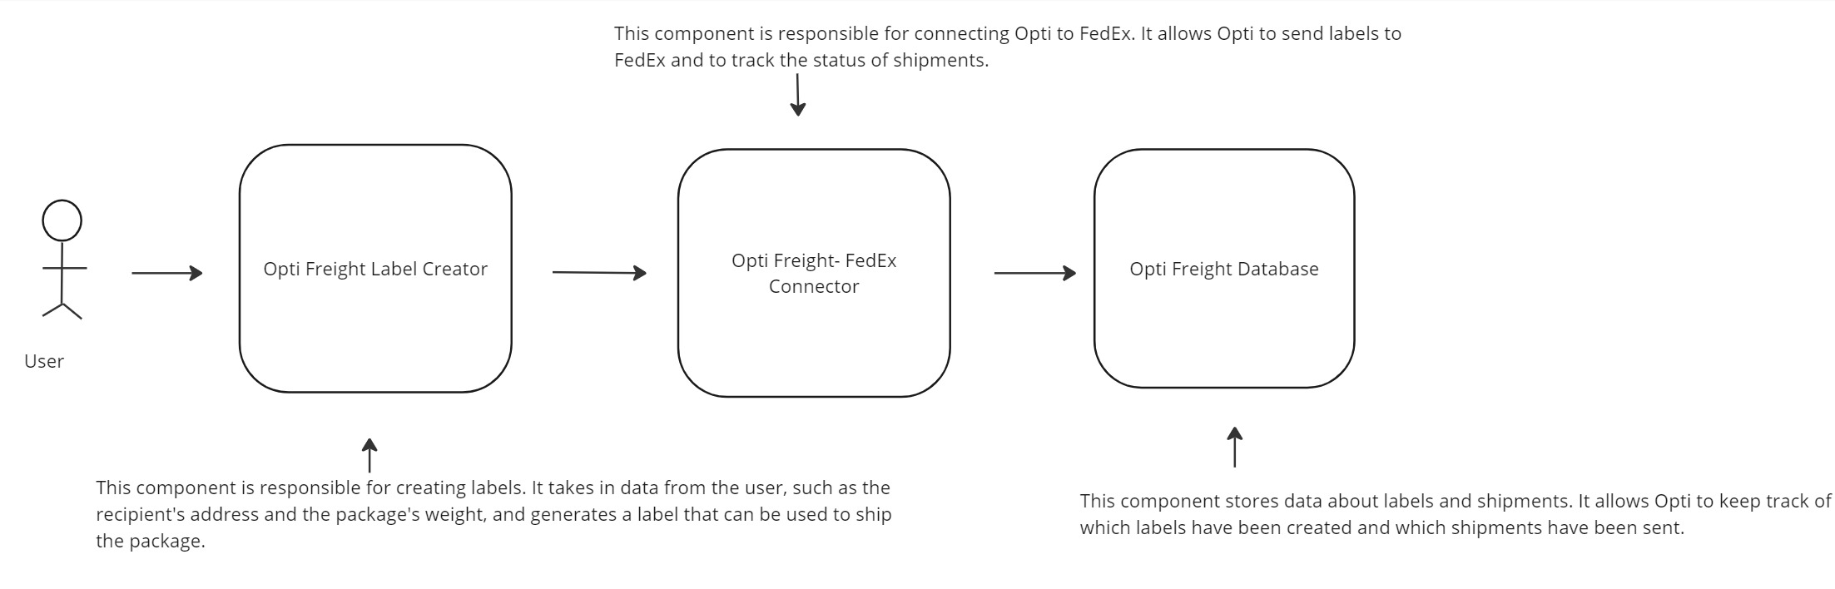
Component connection diagram:

Slide 11
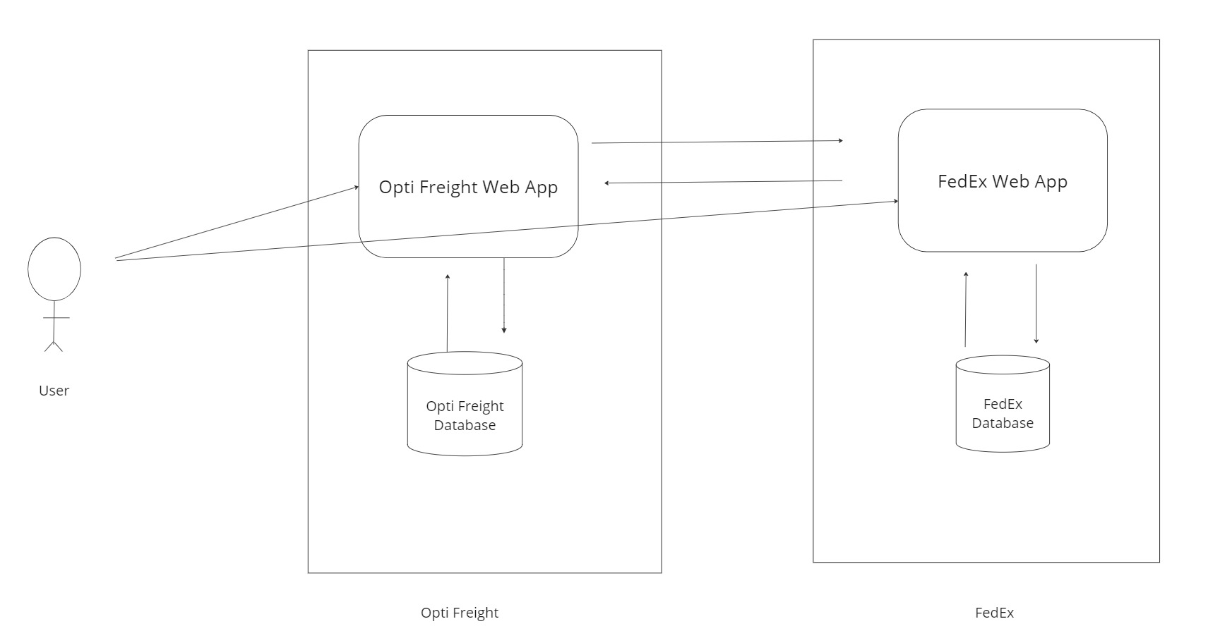
DEPLOYMENT DIAGRAM :

Slide 12
DEPLOYMENT DIAGRAM:
The diagram shows the two main components of Opti Freight: the Opti Freight Web App and the Opti Freight Database. The Opti Freight Web App is where users can browse and purchase equipment. The Opti Freight Database stores information about the equipment, such as its price, availability, and shipping options.
The diagram also shows the two main components of FedEx: the FedEx Web App and the FedEx Database. The FedEx Web App is where users can track their shipments and manage their accounts. The FedEx Database stores information about shipments, such as their status, location, and estimated delivery date.
The arrows between the components show how they interact with each other. For example, the arrow from the Opti Freight Web App to the FedEx Web App shows that the Opti Freight Web App uses the FedEx Web App to create and track shipments.
This deployment diagram provides a high-level overview of the Opti Freight and FedEx systems. It shows the main components of each system and how they interact with each other.

Slide 13
HOW SYSTEM WORKS?
Hospitals or Opti Freight users can buy the required products which are useful for the hospital equipment.
Opti Freight will create a label for the products and give it to FedEx
FedEx will deliver the products to the hospitals.
The Opti Freight system is a third-party service that helps hospitals to buy and receive the products they need. The system is easy to use and provides a convenient way for hospitals to get the supplies they need.

Slide 14
some of the benefits of using the Opti Freight APPLICATION:
Convenience:
The Opti Freight Application is a convenient way for hospitals to buy and receive the products they need. Hospitals can simply order the products they need online and FedEx will deliver them to the hospital.
Accuracy:
The Opti Freight system is accurate and reliable. Hospitals can be confident that they will receive the products they ordered in a timely manner.
Affordability:
The Opti Freight system is affordable. Hospitals can save money on the products they need by using the Opti system.

Slide 15
KEY LEARNINGS:
Planning the non-functional requirements such as scalability, availability, performance, security, modifiability, etc.., is equally important to planning the functional requirements.
The system should be secure, and the data integrity and confidentiality should be maintained.
It's important to consider the end user experience. The system should be easy to use and not compromise on the performance.
The software architecture diagrams should be detailed enough to explain the architectural requirements.
Network exposed services are frequent targets of attack and must be secured accordingly. Typically, such services are secured through appropriate authentication, authorization, and encryption controls.

